Slide 1
Your Remote Assessment

Slide 2
Before Starting
Please do the following:
Confirm you can hear me
Turn on your camera
Remove any camera background
Position your camera so we can see your head, shoulders and upper torso
Turn on your microphone
Confirm you have a stable internet connection

Slide 3
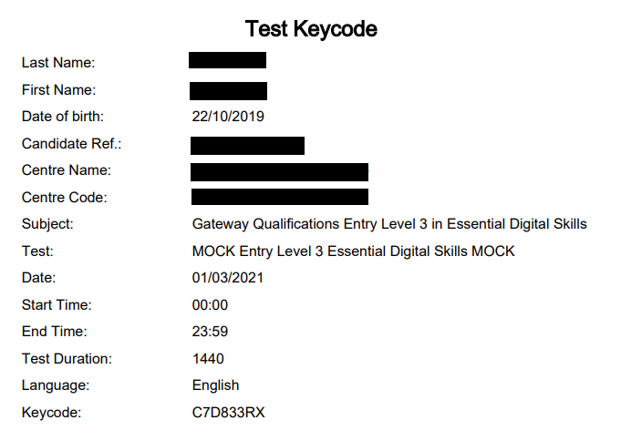
Test Confirmation
Confirm you have your Test Keycode (sent via email)
Confirm the information is correct (name etc.)

Slide 4
Guidance for the Assessment
Your camera and microphone must stay on throughout the assessment
You must always remain in view of the camera (even during any agreed breaks)
You may not talk during the assessment
You must ensure your environment is quiet and you will not be interrupted
You may not use your mobile phone during the assessment
If you have any questions, please use the “Raise hand” function

Slide 5
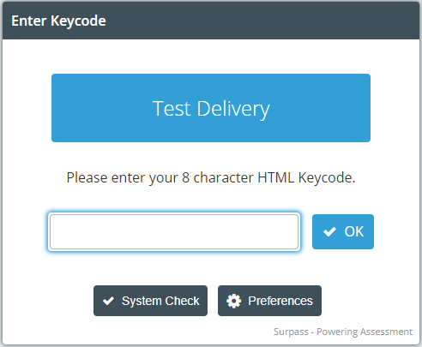
Logging into your Test
Open your Internet Browser
Go to the website:
https://gateway.surpass.com/secureassess/htmldelivery/#!/keycode
You should now see this:

Slide 6
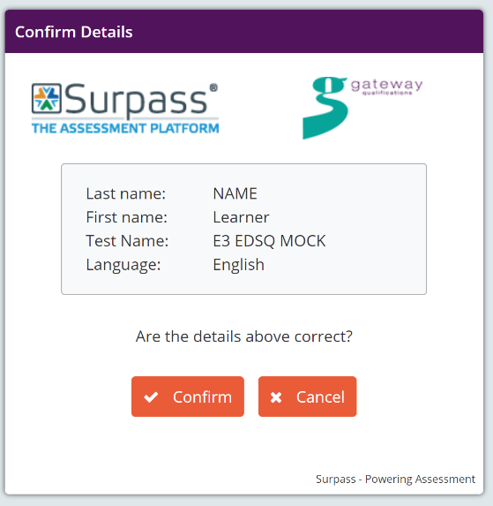
Logging into your Test
Enter the Keycode from your Test Sheet
Click OK
Confirm the information on screen is correct
Click OK
Enter the PIN : <INSERT PIN>

Slide 7
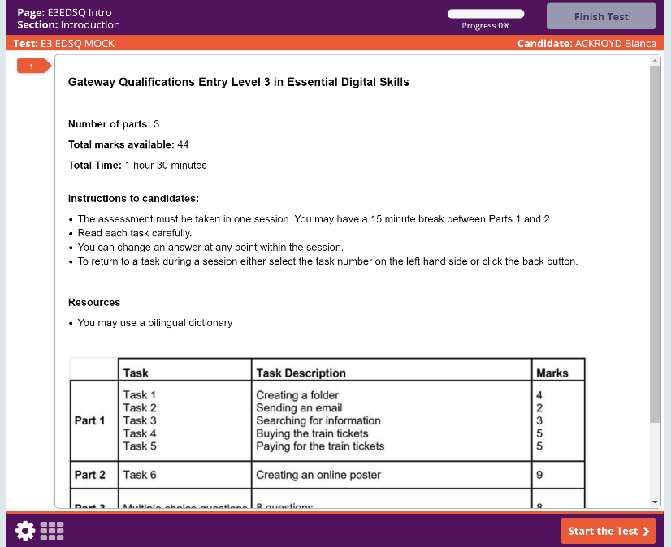
Test Layout
Button to finish and submit your test
Navigation section where you can go back to previously attempted questions
Button to move to next question

